Slide 1

Redux
A Beginner’s Guide to State Management in React
Chankey Nagpal

Slide 2
Agenda
What is Redux?
Why use Redux?
Setting up Redux
Understanding the Store
Action Creators
Reducers
Redux Flow & Demo

Slide 3
What is Redux?
A predictable state container for JavaScript applications
Helps manage application state in a structured way
Works well with React but can be used with other frameworks too

Slide 4
Why Use Redux?
Centralized State Management – Single source of truth
Predictability – State changes happen in a structured way
Easier Debugging – Time-travel debugging, logging, and monitoring
Component Communication – Makes data sharing between components easier

Slide 5
Install Redux and React-Redux: npm install redux react-redux
Create a Redux store
Provide the store to the app using <Provider>
Redux Setup

Slide 6
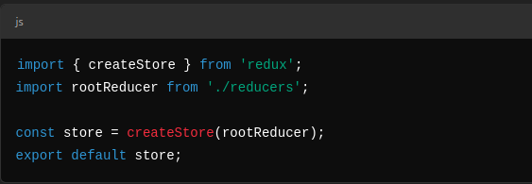
The Store
The Redux store, simply put, is an object that holds the application state. A redux store can consist of small state objects which are combined into one large object. Any component in the application can easily access this state (store) by hooking up to it through the connect method.
Holds the entire state of the application
Created using createStore() (or configureStore() with Redux Toolkit)
Example :

Slide 7
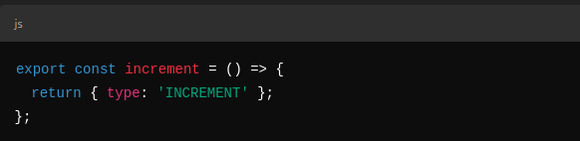
Action Creators and Actions
Action creators, as the name suggests, are functions that return actions (objects). Action creators are invoked when the user interacts with the application through its UI (button click, form submission, etc) or at certain points in a component’s lifecycle (component mounts, component un-mounts, etc).
Actions describe what should happen in the app
Action Creators are functions that return action objects
Actions are simple objects which conventionally have two properties- type and payload. The type property is usually a string that specifies identifies the action, and the payload is an optional property that contains some data that is required to perform any particular task. The main function of action is to send data from the application to the Redux store.
Example :

Slide 8
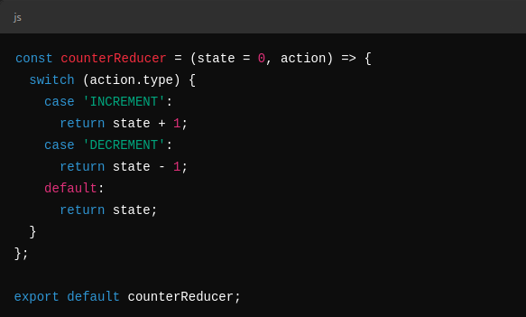
Reducers
Reducers are pure functions that update the state of the application in response to actions. Reducers take a previous state and an action as the input and return a modified version of the state. Since the state is immutable, a reducer always returns a new state, which is an updated version of the previous state.

Slide 9
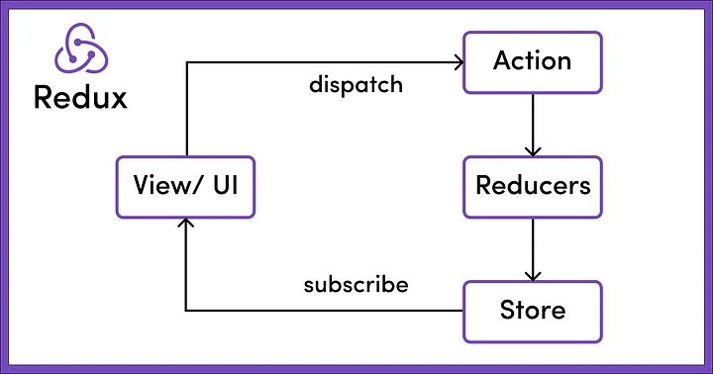
Redux Flow
Component dispatches an action
Action is sent to the reducer
Reducer updates the store
Components rerender with the new state

Slide 10
Demo

Slide 11
Thank You

